Slide 1
ChatDB Demo
By Group 19
Xiaolong Wen，Guangze Liu

Slide 2
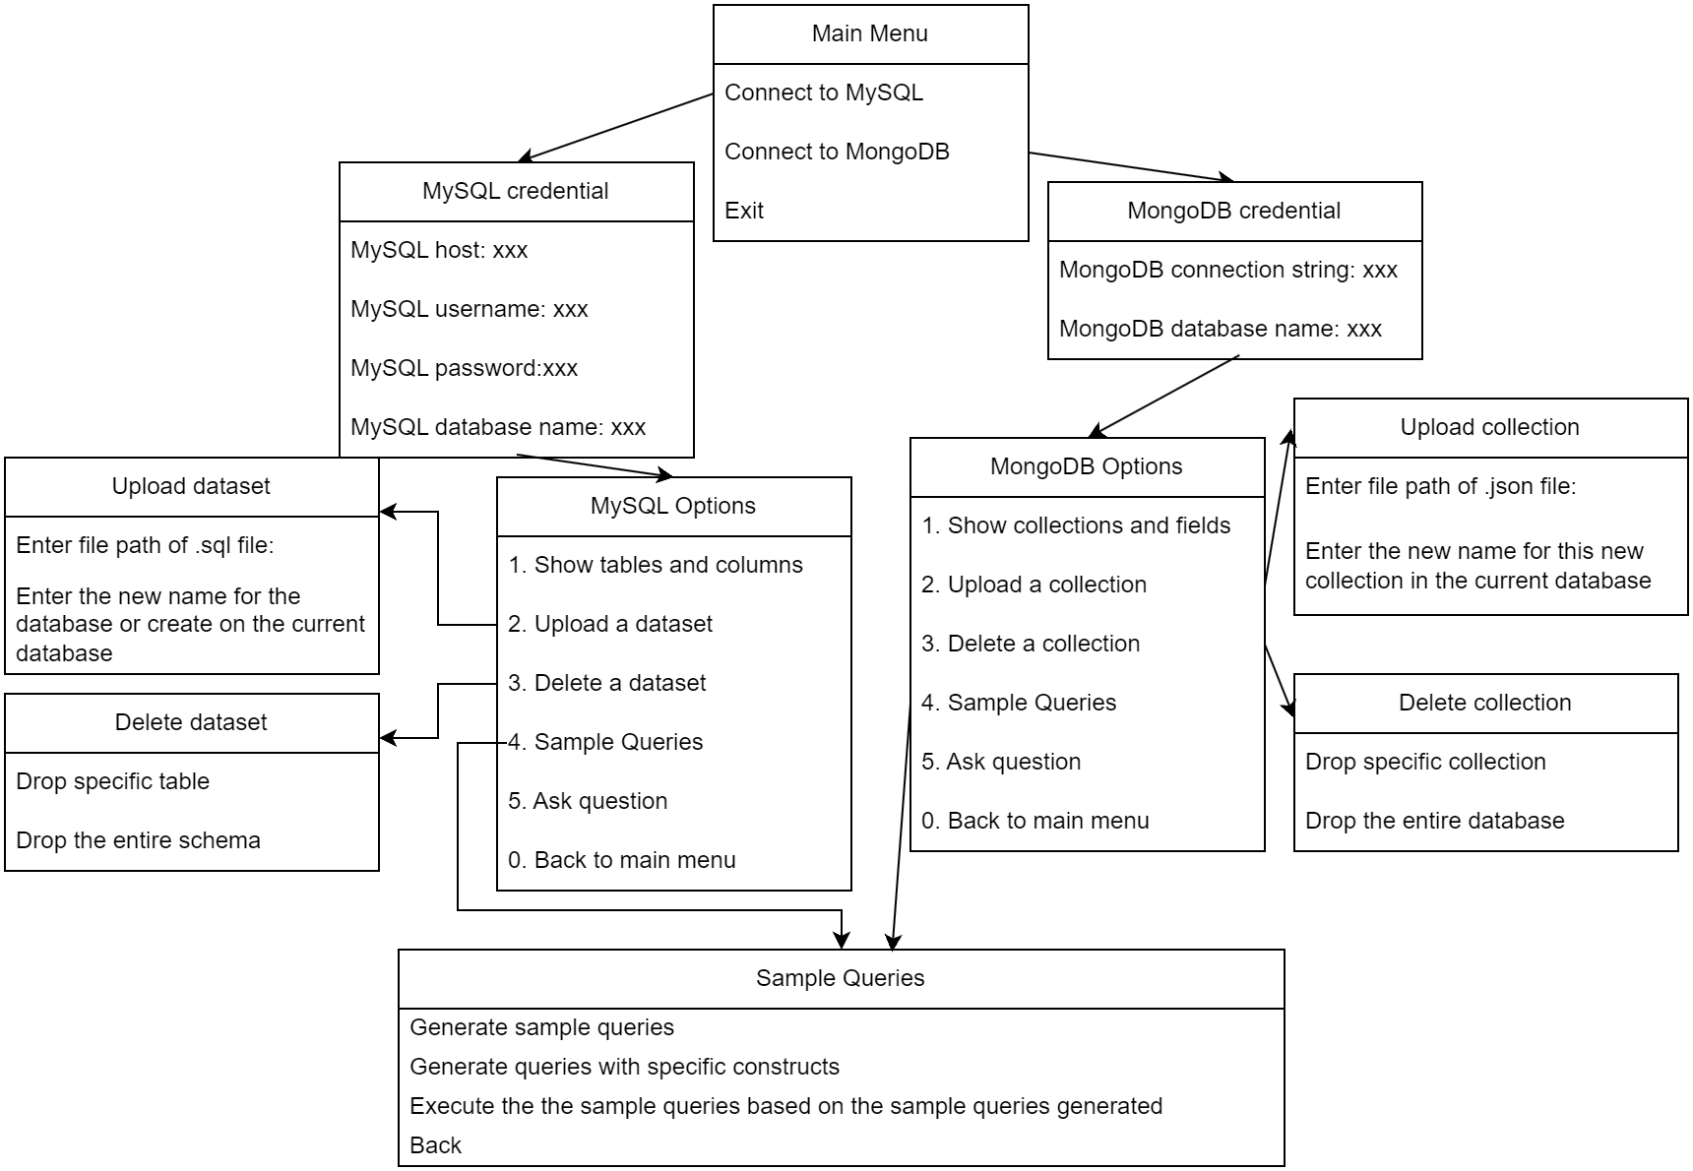
Pipeline

Slide 3
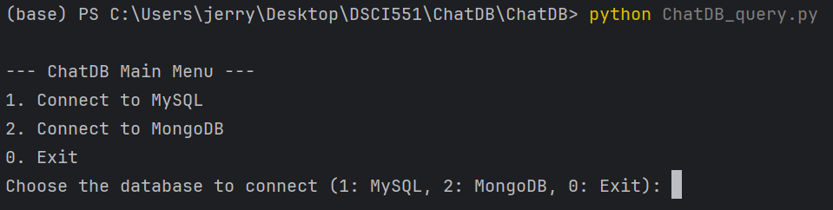
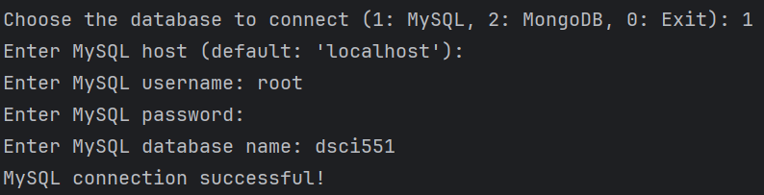
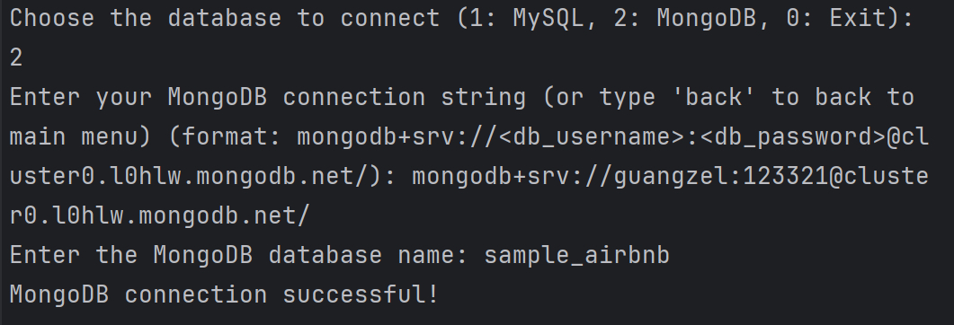
Main Menu
Once the script starts:
Select the database type (MySQL or MongoDB).
Provide the necessary credentials (e.g., host, username, password, MongoDB connection string).
When user enter the password for MySQL, their input will be hidden

Slide 4
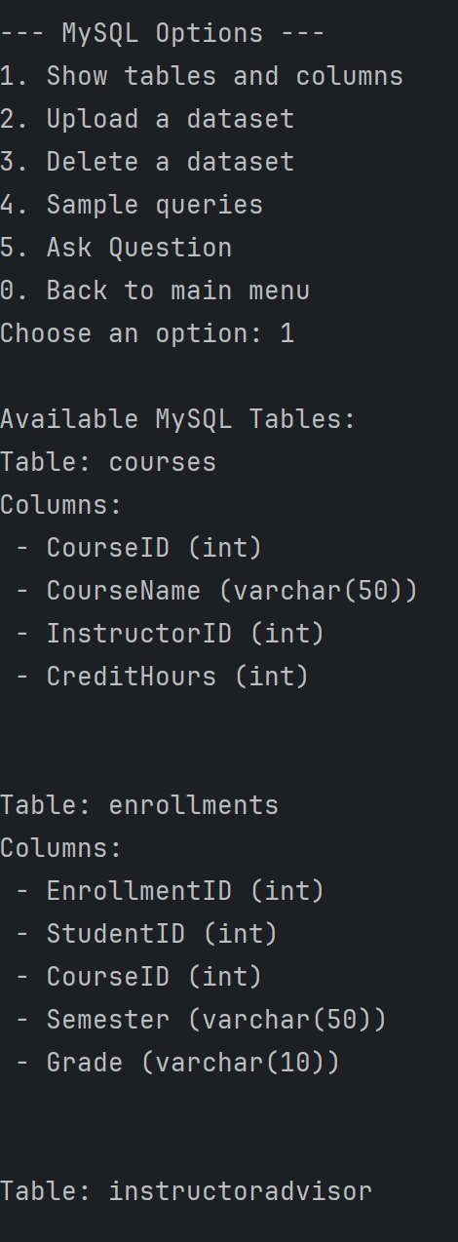
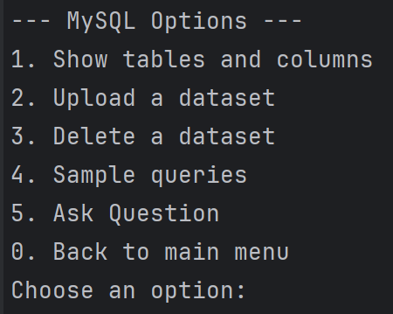
MySQL
Show Tables and Columns: View all tables in the current schema and their columns.
Upload Dataset: Upload .sql files to the connected MySQL database for creating or populating tables.
Delete Dataset: Drop specific tables or the entire schema.
Switch Schema: After dropping a schema, select another existing schema or create a new one.
Ask question: Process the natural language query and map it to a SQL query
Generate Sample Queries: Create basic and advanced queries based on available tables.

Slide 5
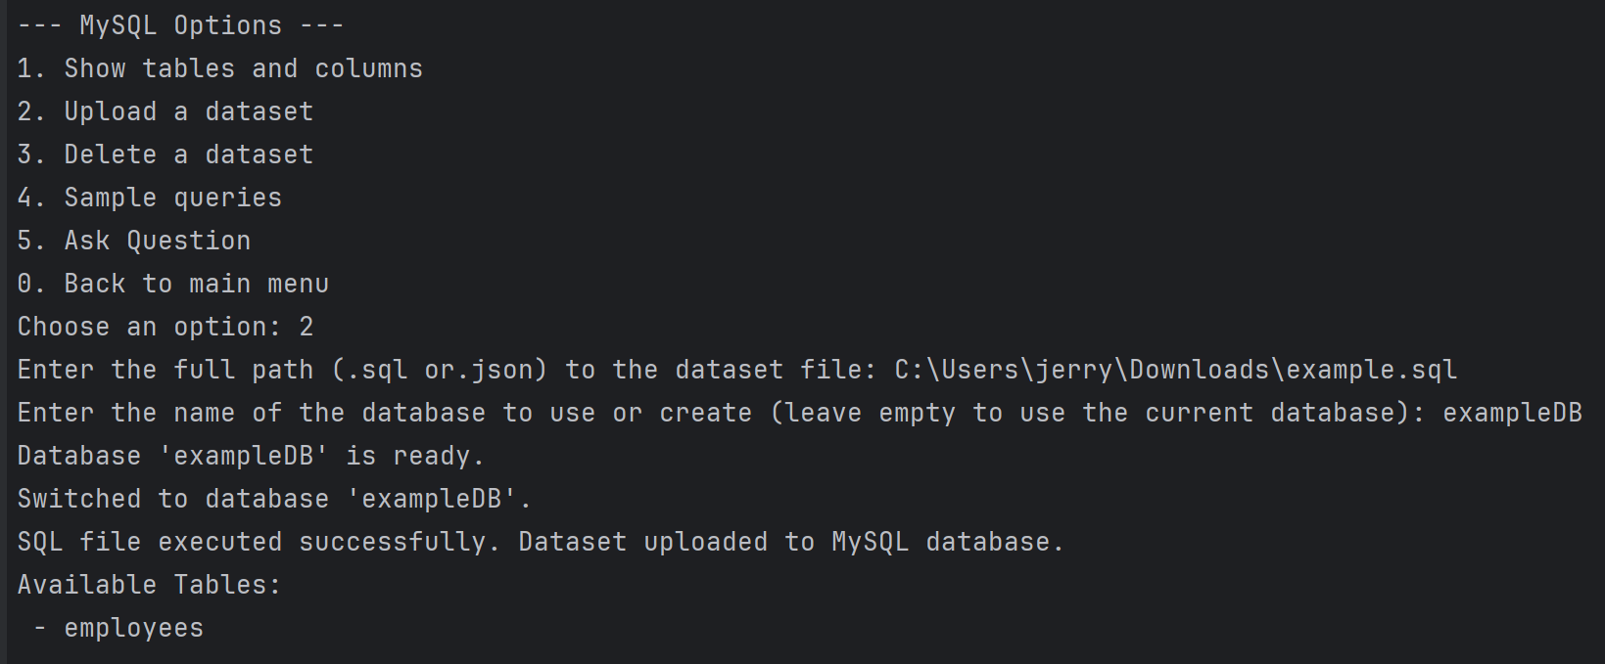
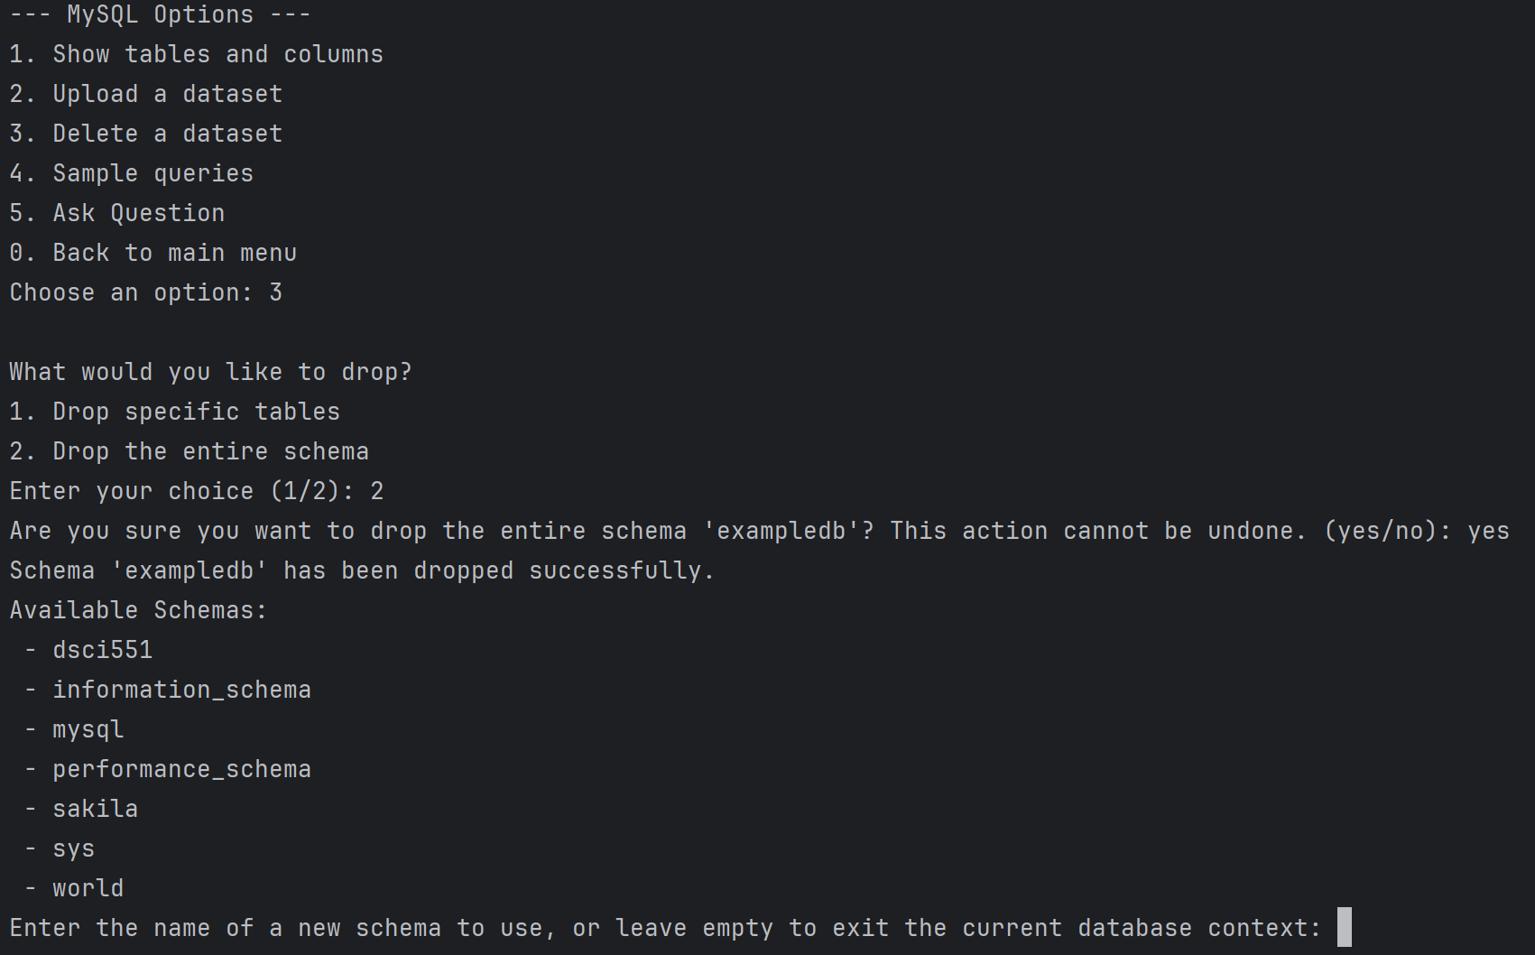
Mysql: Upload or delete dataset (.sql)

Slide 6
MySQL: Sample Queries and Sample with constructs
Sample queries: Generate a set of sample queries based on table schema and column data types.
Fetch Tables and Columns:
Retrieves tables in the database and their respective columns.
Identifies column types (e.g., numeric, text) and key columns (primary/foreign).
Dynamic Query Patterns:
Creates reusable query templates based on field types and relationships:
Randomly selects queries, executes them, and includes only those that return meaningful results.
Sample queries with constructs: Generate queries focused on specific SQL constructs (e.g., GROUP BY, HAVING, JOIN, EXISTS, ORDER BY)
Construct Queries Based on SQL Constructs:
For each construct:
GROUP BY: Aggregate numeric columns grouped by text or key columns.
HAVING: Filter groups after aggregation.
JOIN: Combine related tables based on keys.
EXISTS: Check the existence of related records.
ORDER BY: Sort records by numeric, text, or date fields

Slide 7
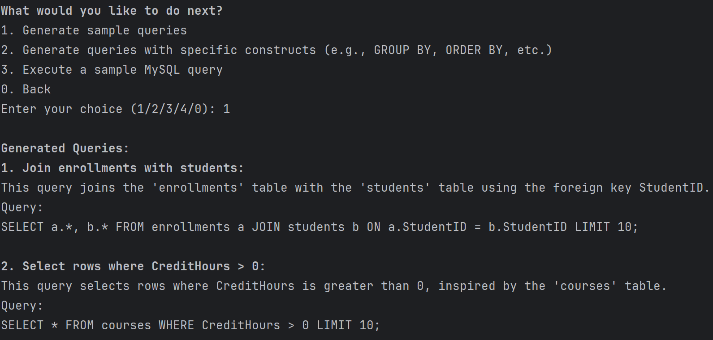
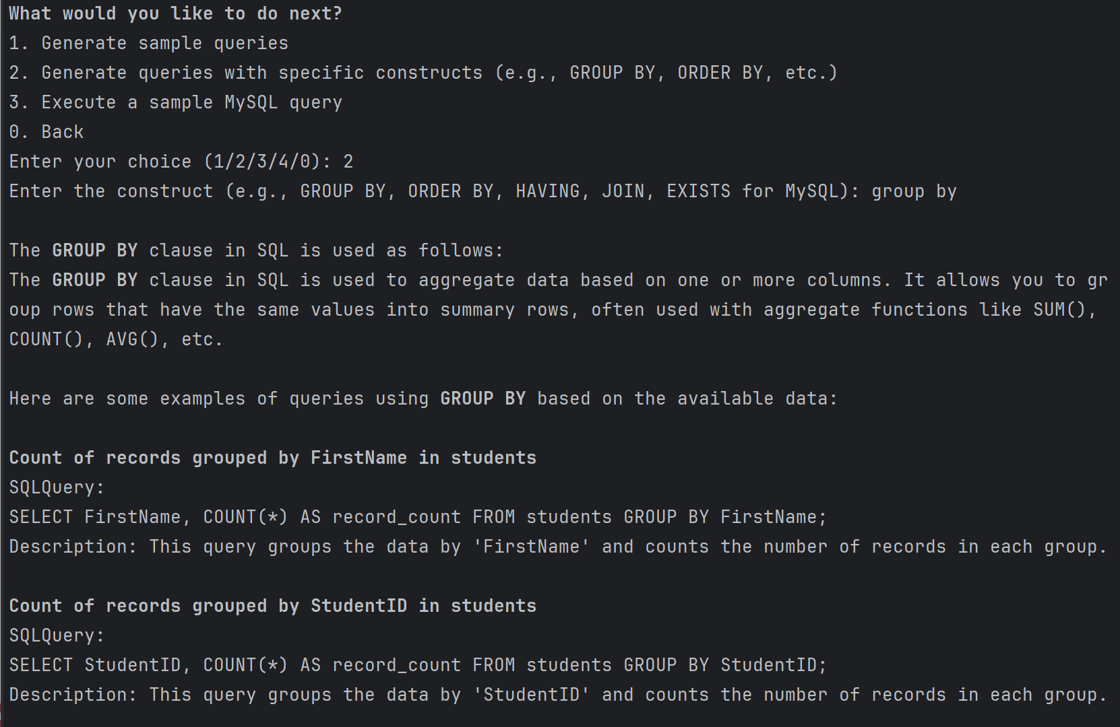
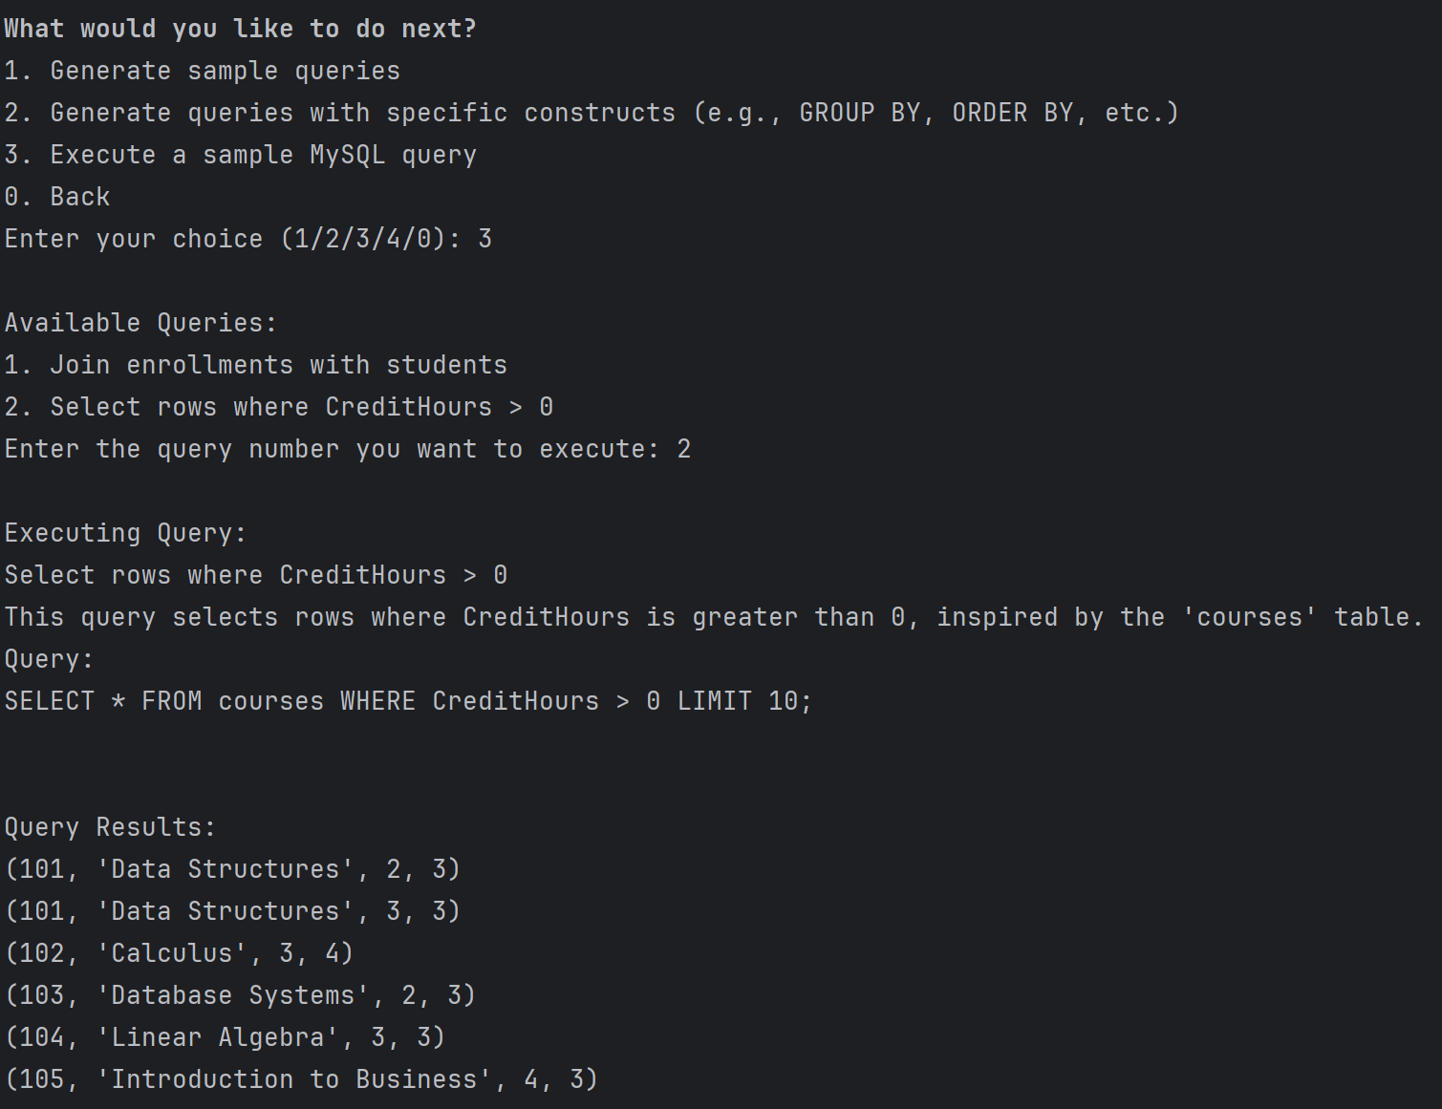
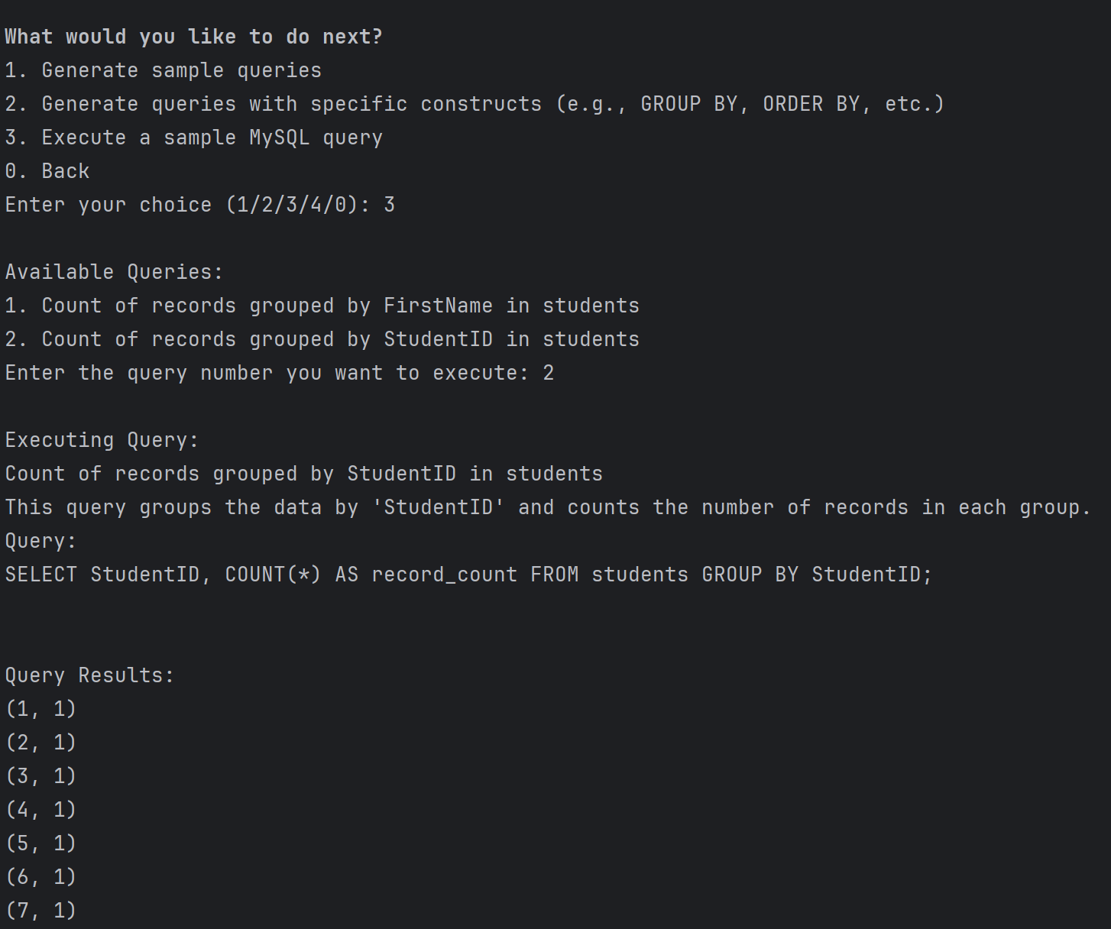

Slide 8
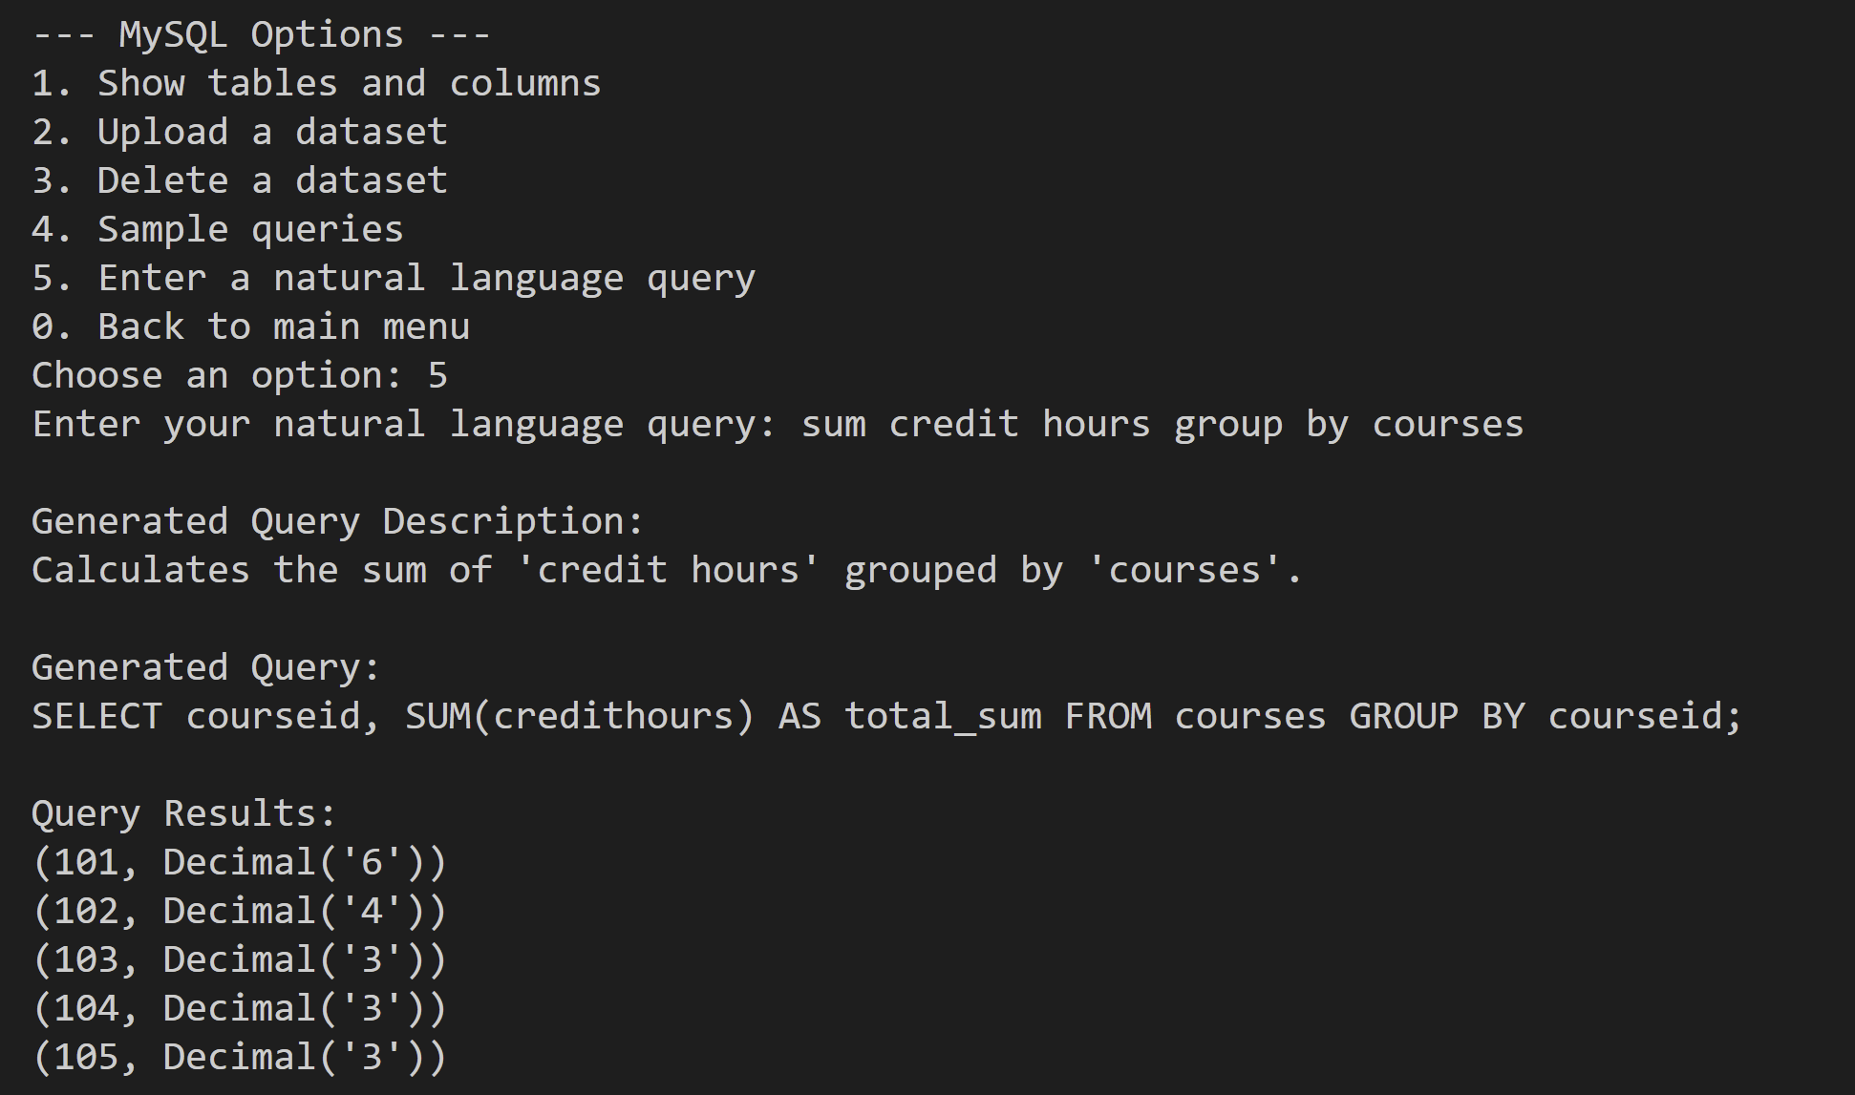
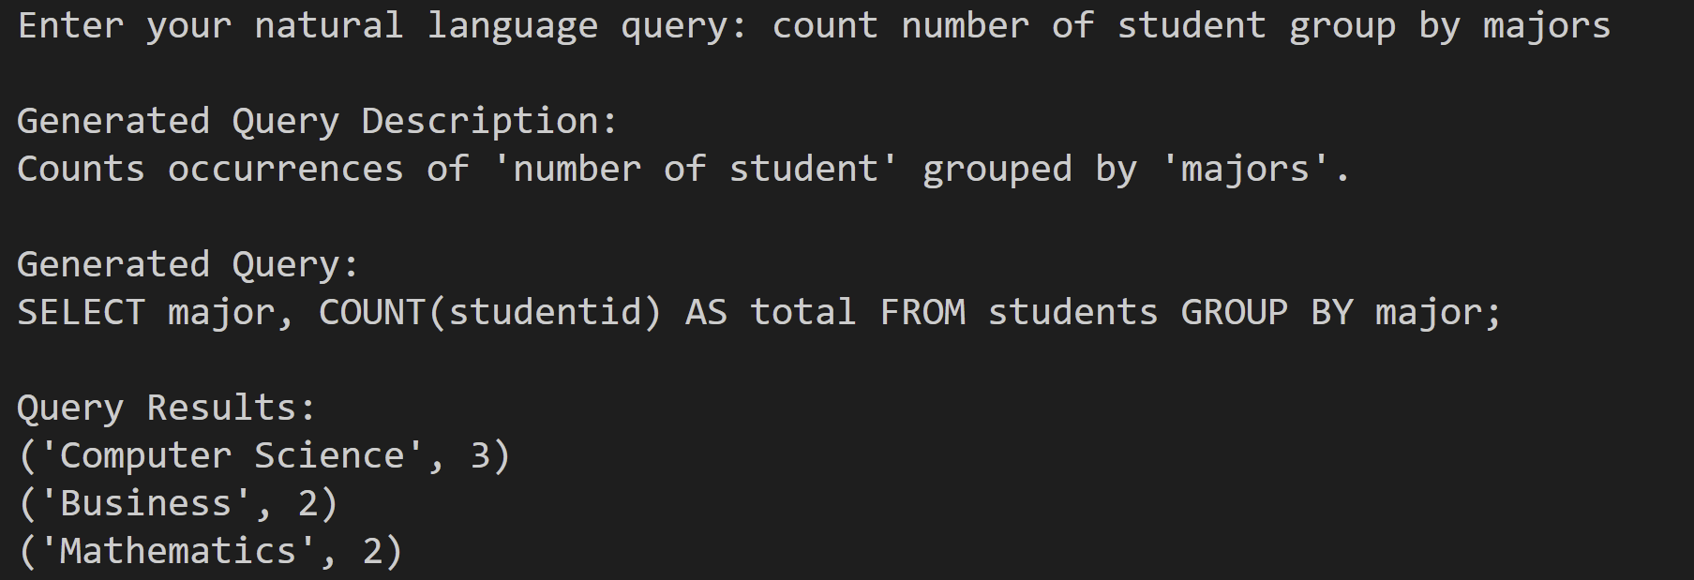
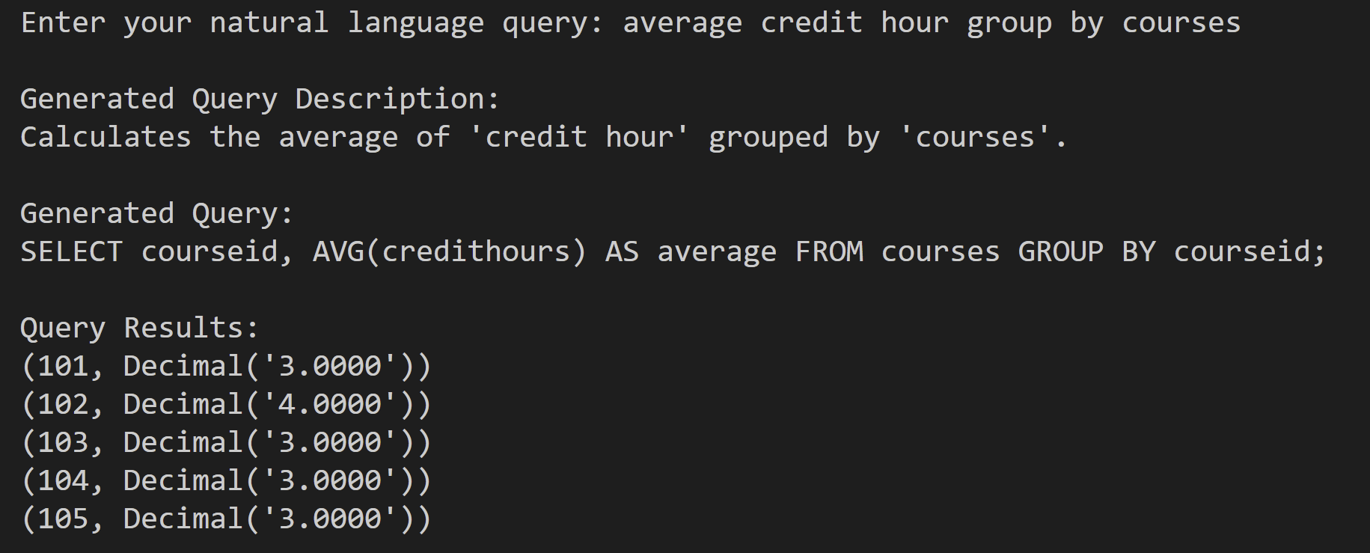
MySQL: Q&A in Natural Language
Allow user to ask simple questions to perform simple tasks on the current database.
Basic workflow:
Pattern Matching:
Matches user query to predefined SQL patterns.
Example Pattern: (count|number of|how many)...group by...
Field Mapping:
Maps user terms to schema field names using:
Normalization: Tokenization, lemmatization, and stopword removal.
Similarity Matching: Uses difflib.get_close_matches to find schema matches.
Example: "majors" → "major".
SQL Query Construction:
Combines matched patterns and mapped fields to generate the SQL query.

Slide 9
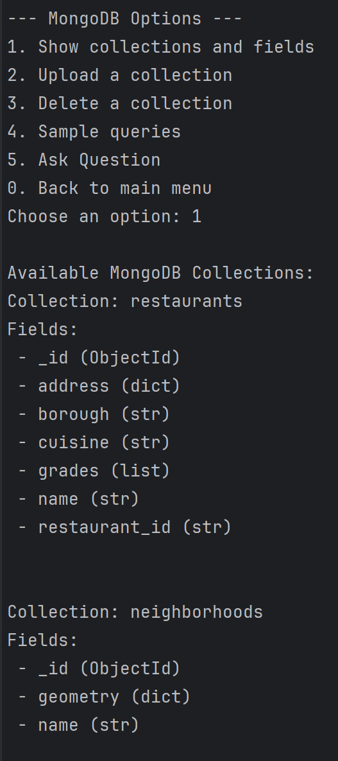
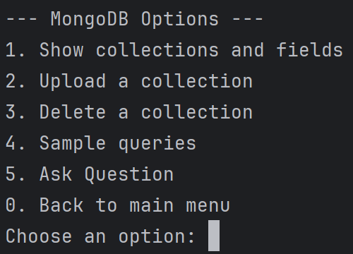
MongoDB
Show Collections and Fields: List all collections in the current database and explore their field structures.
Upload Dataset: Insert .json files into the connected MongoDB database as collections.
Delete Dataset: Drop specific collections or the entire database.
Switch Database: After dropping a database, choose an existing one or create a new database.
Ask question: Process the natural language query and map it to a MongoDB query
Generate Sample Queries: Generate MongoDB aggregation pipelines and queries based on collections.

Slide 10
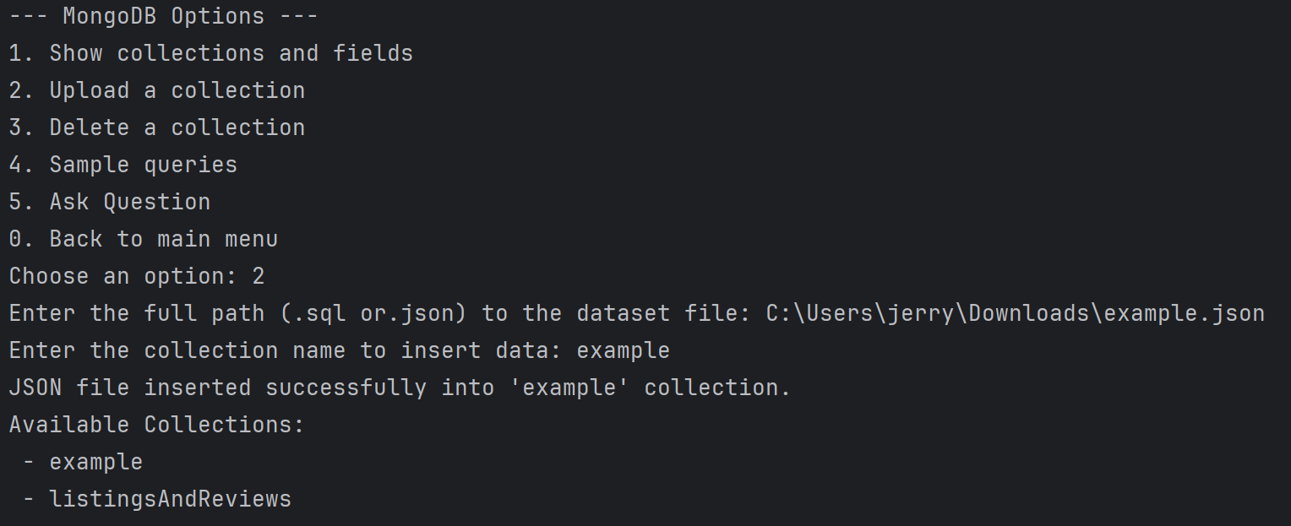
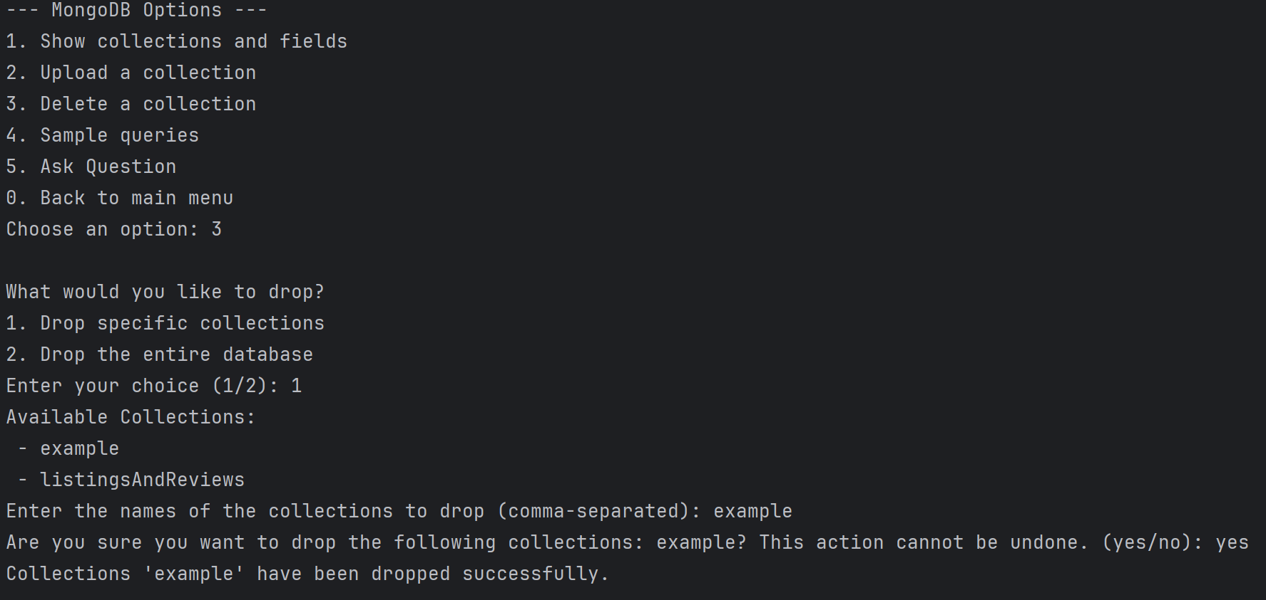
Upload or delete collection (.json)

Slide 11
MongoDB: Sample Queries and Sample with constructs
Sample queries: Generate general-purpose sample queries for MongoDB collections based on their schema and content.
Schema Inspection:
Analyzes collections and identifies numeric, text, and date fields from a sample document.
Dynamic Query Generation:
Generates queries for:
Aggregations ($sum, $avg).
Text search ($regex).
Sorting ($sort).
Filtering numeric fields (>, BETWEEN).
With construct queries: Generate queries focused on specific MongoDB constructs (e.g., $match, $group, $sort, $limit) for deeper insights into the database
Construct-Specific Querying:
Generates queries for a specified MongoDB construct:
$match: Filtering based on numeric, text, or date fields.
$group: Aggregations grouped by fields.
$sort: Sorting by fields in ascending or descending order.
$limit: Restricting results or implementing pagination.
Each construct focuses on its corresponding query stage.
Schema-Based Querying:
Uses schema information to generate construct-relevant queries.

Slide 12
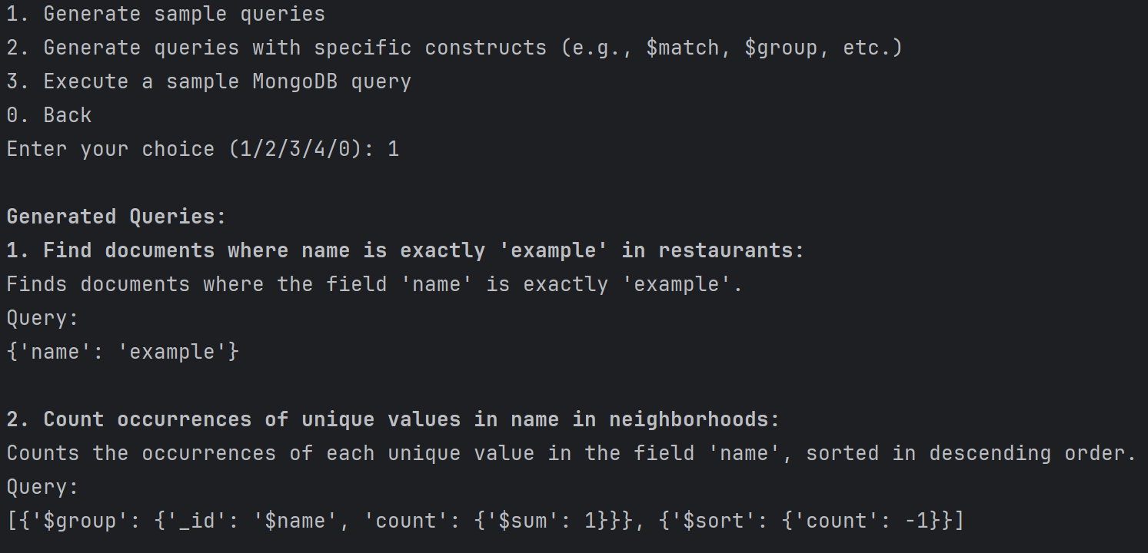
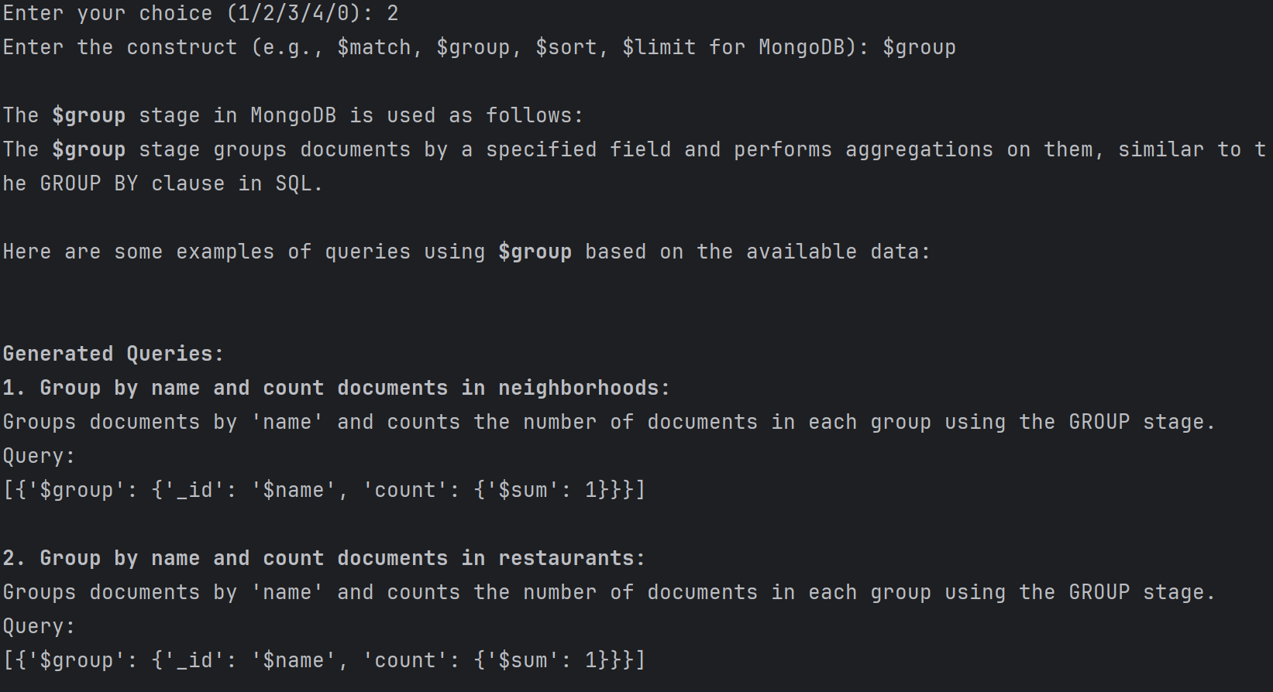
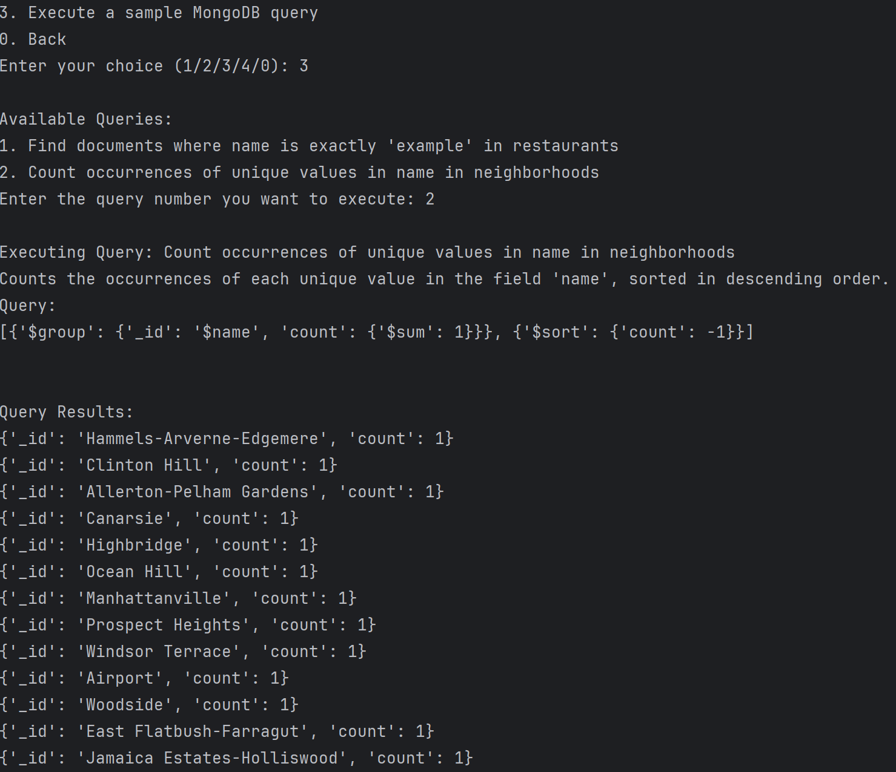
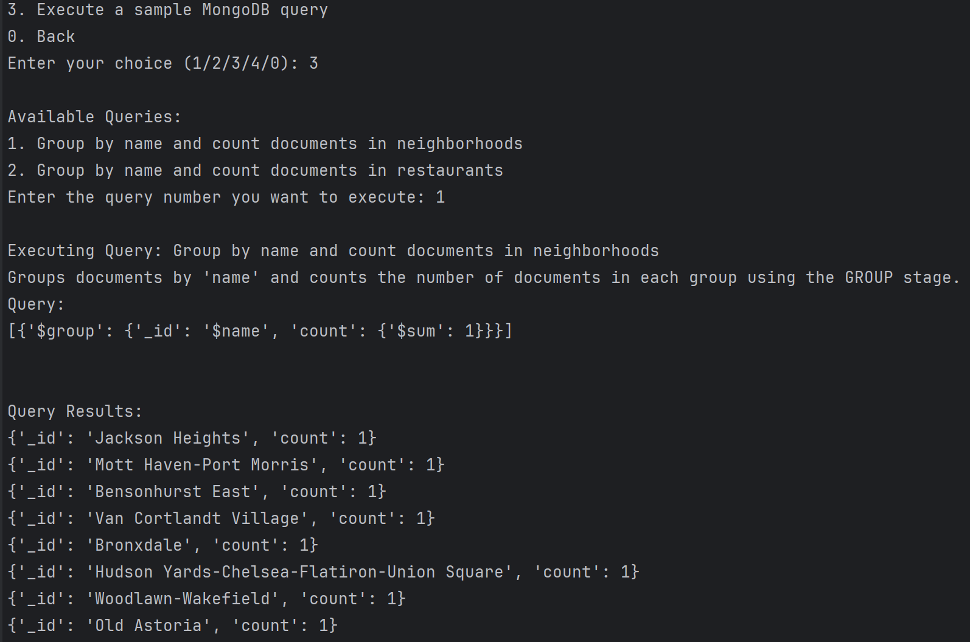

Slide 13
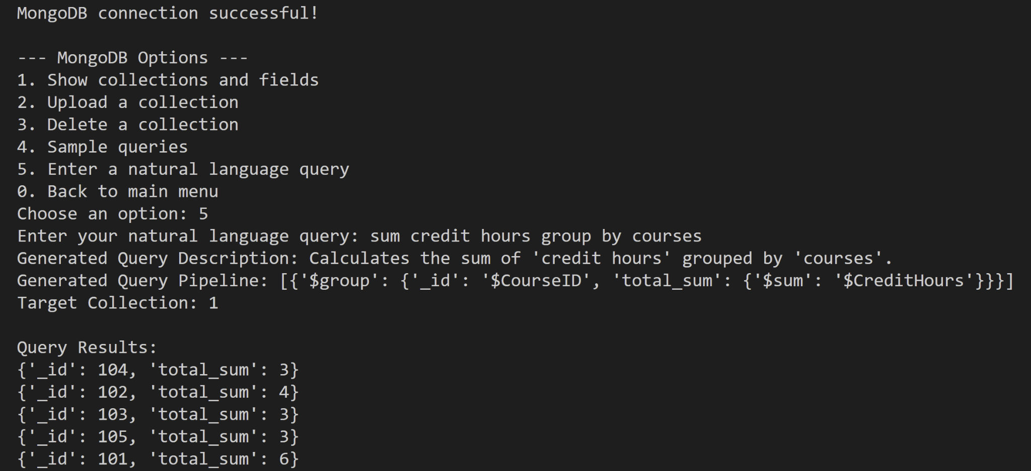
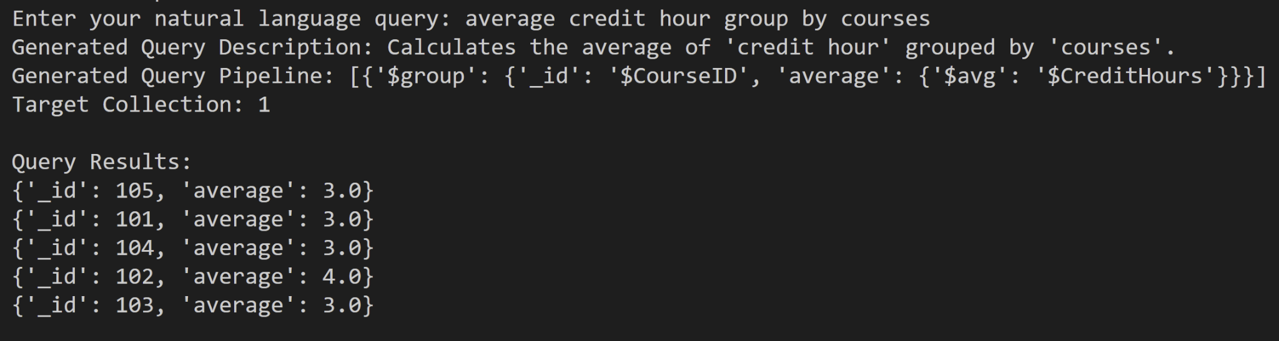
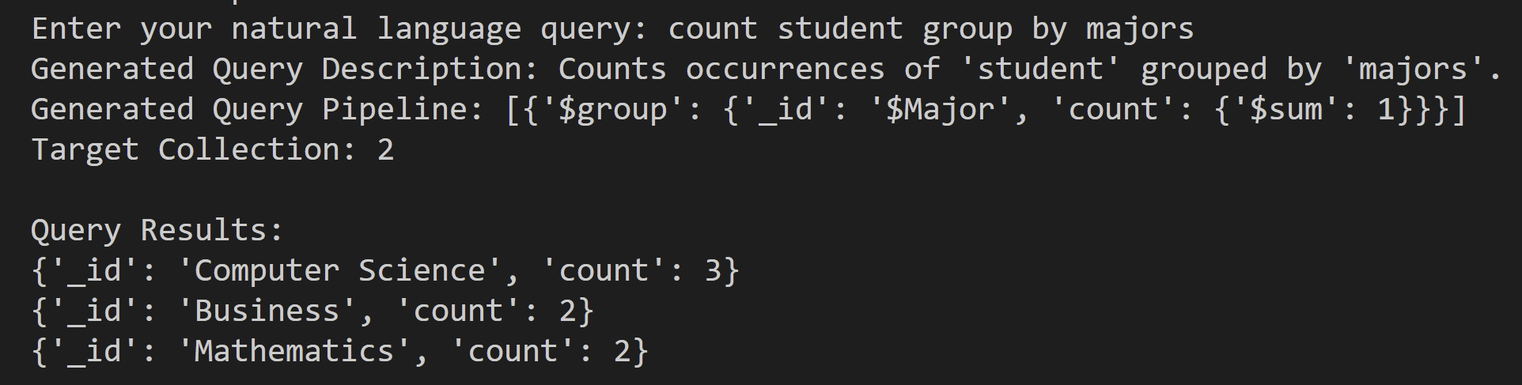
MongoDB: Q&A in Natural Language
Allow user to ask simple questions to perform simple tasks on the current database.
Basic workflow
Schema Inspection:
Extract field names from a sample document in each collection.
Pattern Matching:
Matches user query to predefined MongoDB patterns using regex.
Field Mapping:
Ensures user terms are mapped to actual fields.
E.g., "region" → "region" ; "sales" → "sales"
Collection Identification:
Locates the collection containing all required fields.
Pipeline Construction:
Generates an aggregation pipeline based on matched patterns and mapped fields.

Slide 14
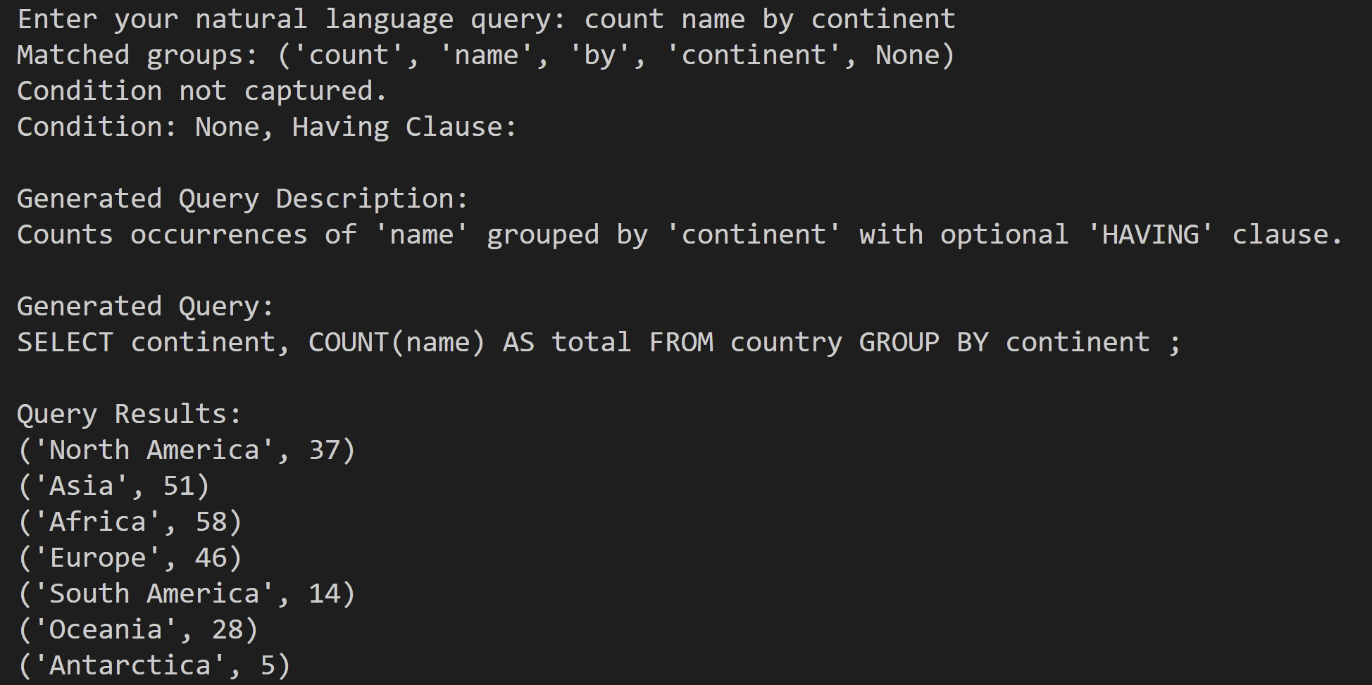
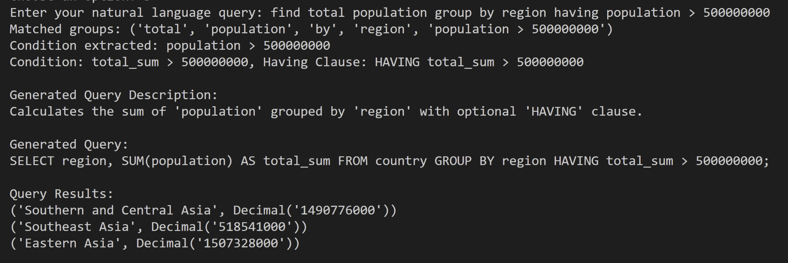
Other Test case(world)

Slide 15
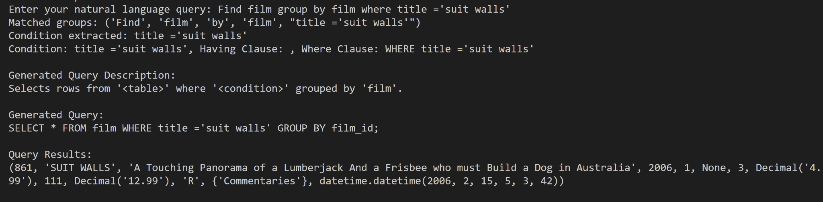
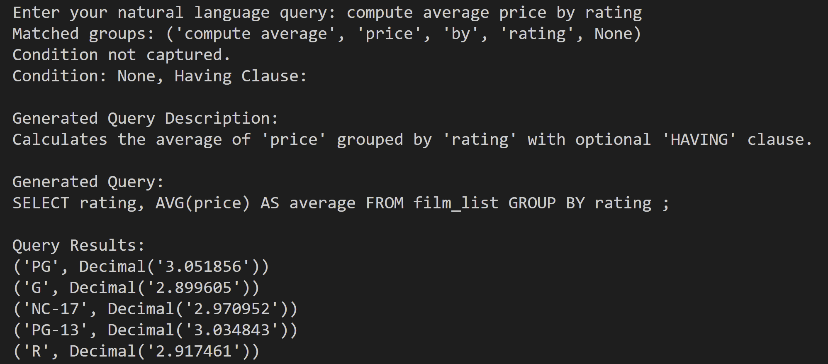
Other Test cases(Sakila)

Slide 16
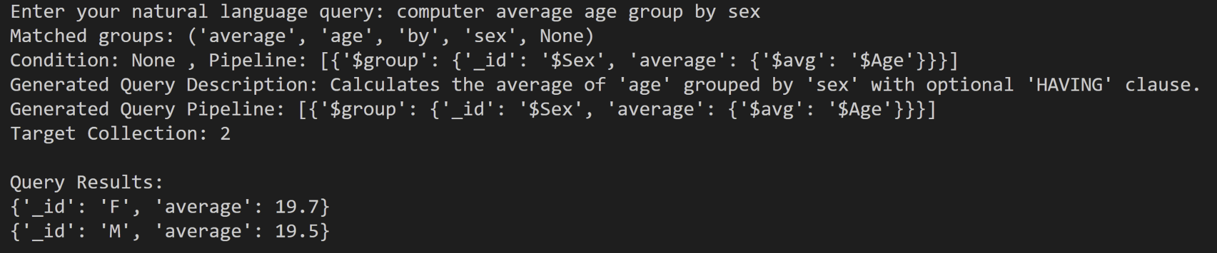
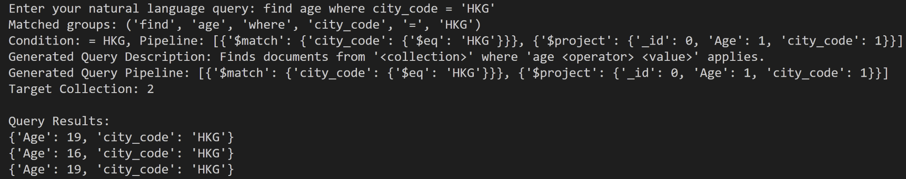
Other Test cases(student)

Slide 17
Thank You!
References Datasets used for testing:
MySQL: MySQL Example datasets: https://dev.mysql.com/doc/index-other.html
Sakila database on MySQL Example datasets
World database on MySQL Example datasets
Students and enrollments datasets from Hw3
MongoDB: Sample databases from MongoDB cloud:
Sample_student_info
Sample_restaurants
Students and enrollments database from Hw3(transformed to .json format)
Find more details: https://github.com/GuangzeLiu/ChatDB_DSCI551

